Slide 1
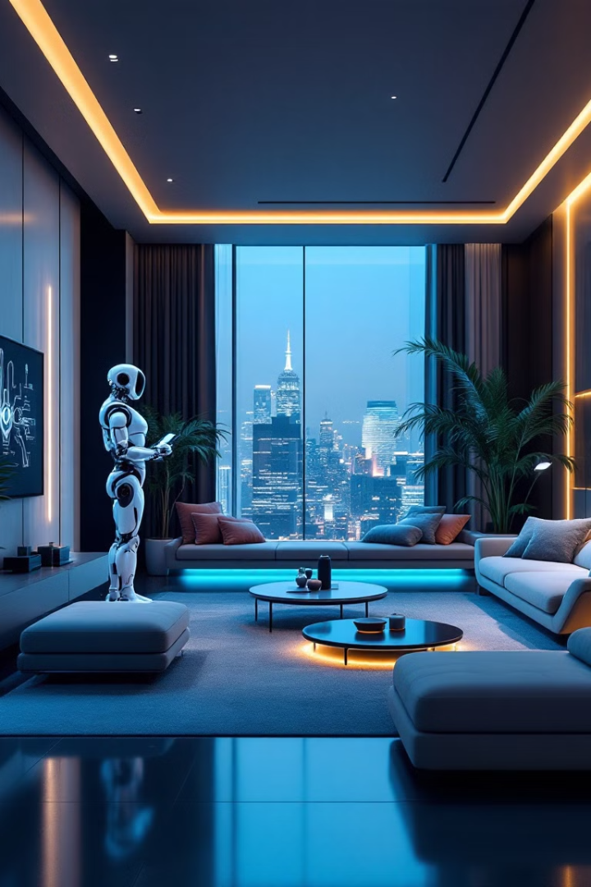

IOT WITH AI
Revolutionizing THE manual world.
BY : Team-7

Slide 2
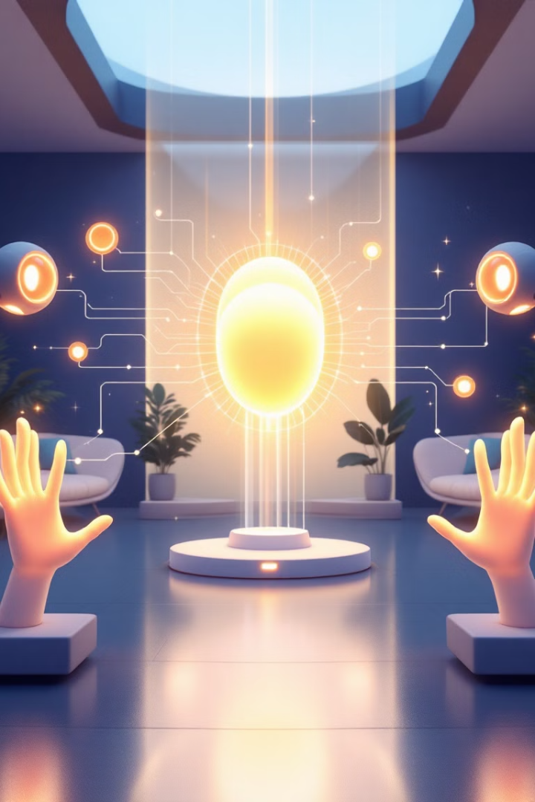
Objective Of our CREATION
Convenience
Time/resource Saving
Streamline home/Office
management.
Everyday task made easier and
No wasted of resource is insured
Security
A home Assistant
Enhance home safety.
Command your place like a friends. Also for chitchat

Slide 3
What We Created
AI Assistant ,
Able to control home Appliances(light, fan, motors)
Able to Receive data from the sensors (smoke , IR sensors),
While also being able to search the web for queries,
Can learn during conversations (Data Train)

Slide 4
Time for demo..

Slide 5
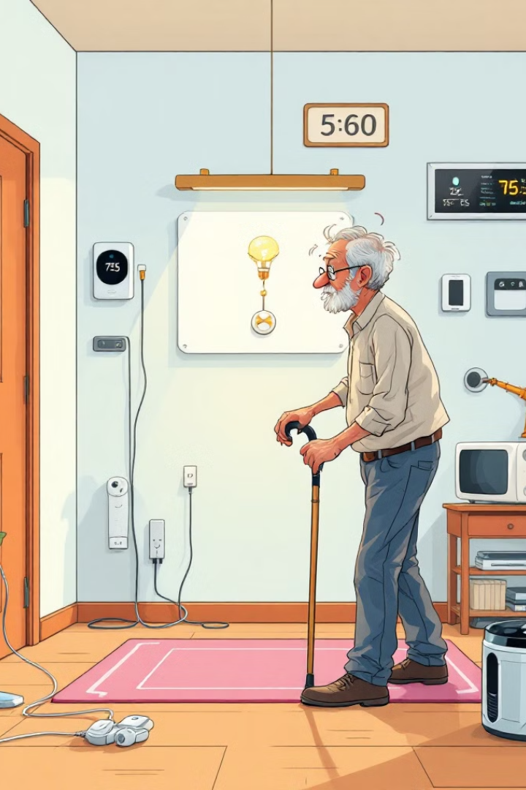
Problem It solves
Accessibility Issues
Energy Waste
Light switches, fan controls
Smart Approach to Save energy.
Unawareness
Time Management
Easy Web search and updates.
Hectic life
The problem it solves is the problem faced because of physical challenges

Slide 6
What It Can Evolve To…
Integration with other smart systems
Advance Learning
Energy Optimization
Seamless interaction between different smart home ecosystems (e.g., smart lighting, appliances).
In this data doesn’t need to be manually trained
Reduce energy consumption by dynamically adjusting settings.
1
2
3
4
5
6
Enhanced Security
Personalized Automation
Data Analytics and Insights
AI-powered security systems detect intrusions and threats (e.g., Amazon Ring's doorbell). Use ai camera.
Create custom routines and schedules based on user preferences and data.
Generate valuable data for improving home efficiency and user experience (e.g., energy consumption reports).
THE GROWTH OF THIS IS LIMITED WITH THE LIMITATIONS OF THE MIND

Slide 7
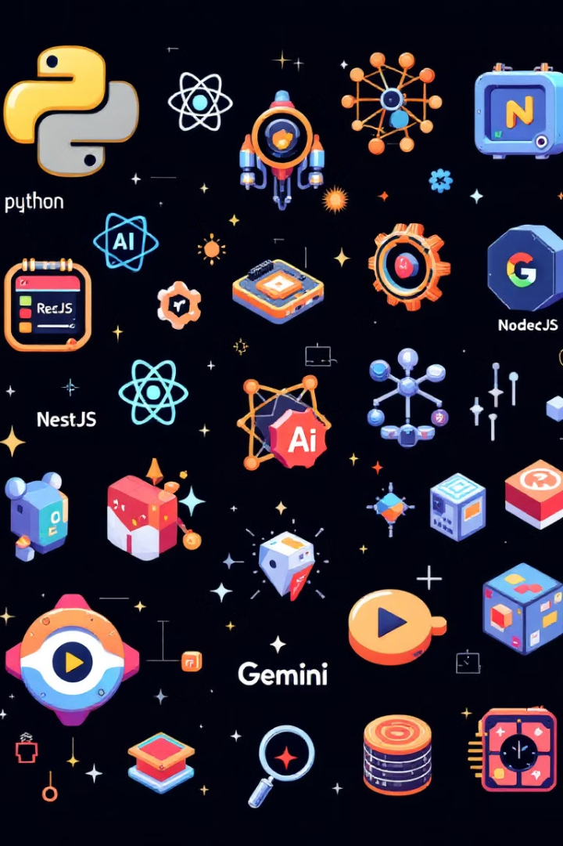





Technical Stack
Python
Ardino Uno
AI and Backend Handling
For programing the Hardware &
Device control
Html/ CSS/ JS
Git Hub
Front end development
Collaborative Development

Slide 8
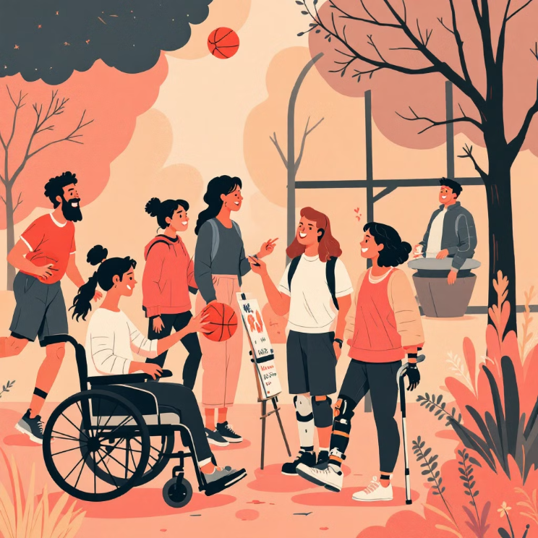
Targeted Users..
Old aged people
Disabled people
Tech Enthusiasts
Busy Professionals
Security Need

Slide 9

Sector Applications
Economic
Energy savings, efficiency,
Security
Prevention
Personal
Convenience, comfort, accessible,
informative.

Slide 10
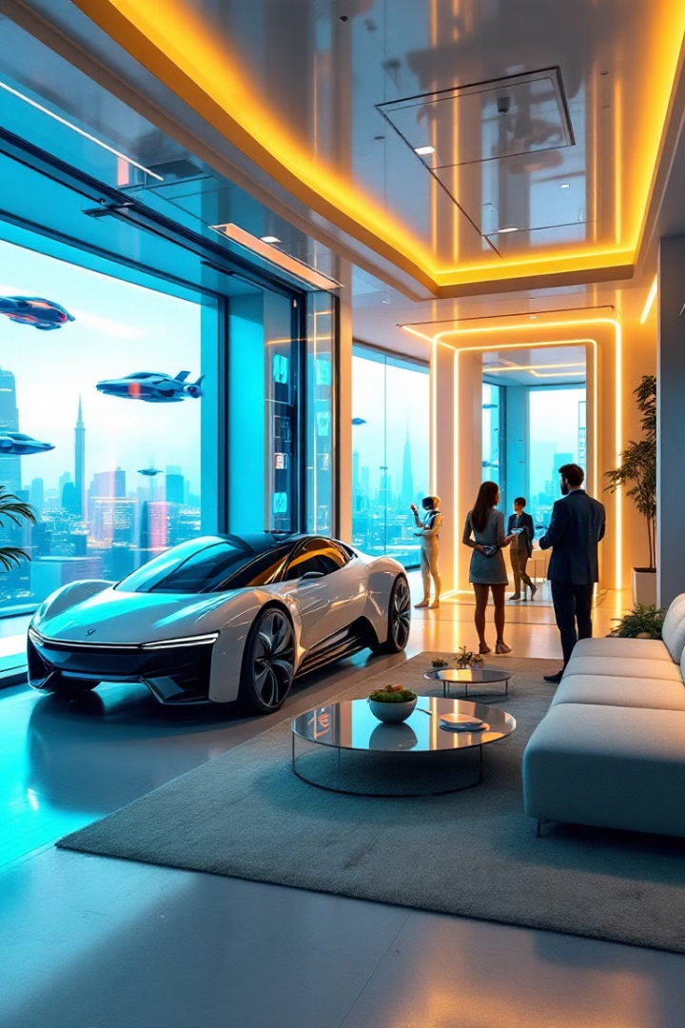
Thank You

